Slide 1
Microservices

Slide 2
agenda
Introduction
Why Microservices ?
What Is Microservices ?
Features Of Microservice Architecture
Advantages Of Microservice Architecture
Best Practices To Design Microservices
Q&A

Slide 3
Microservices-introduction
A microservices architecture is a type of application architecture where the application is developed as a collection of services. It provides the framework to develop, deploy, and maintain microservices architecture diagrams and services independently..
Microservices are software engineering pattern / architecture which divides an application into several tiny, autonomous services that connect with one another via APIs.
Within a microservices architecture, each microservice is a single service built to accommodate an application feature and handle discrete tasks. Each microservice communicates with other services through simple interfaces to solve business problems

Slide 4
Why Microservice ?
Microservices were utilized to solve the issues of monolithic architecture that dominated the market at first, and they also allow you to deploy separate services.

Slide 5
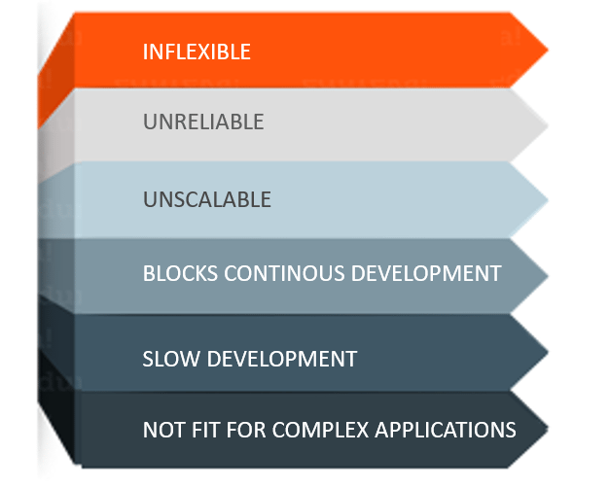
Challenges of Monolithic Architecture

Slide 6
What is Microservice
Microservices is an architectural style that structures an application as a collection of small autonomous services, modeled around a business domain.

Slide 7
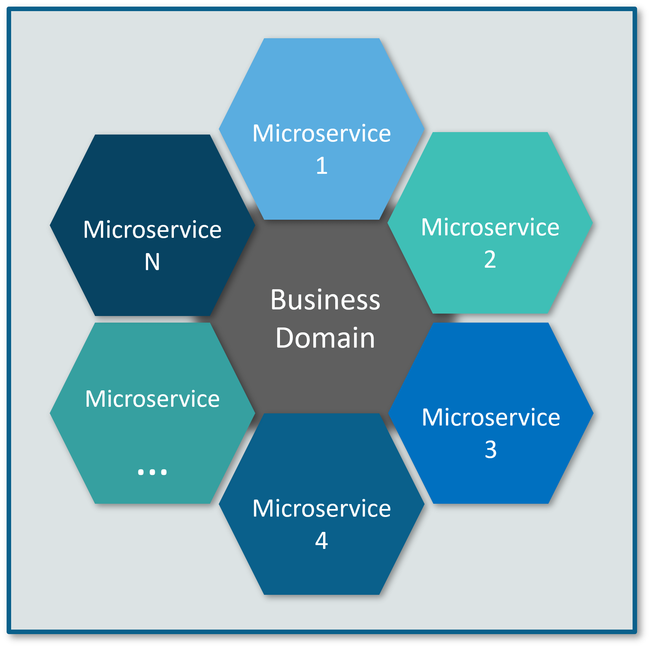
Architecture
In the given Architecture, each service is self-contained and implements a single business capability.

Slide 8
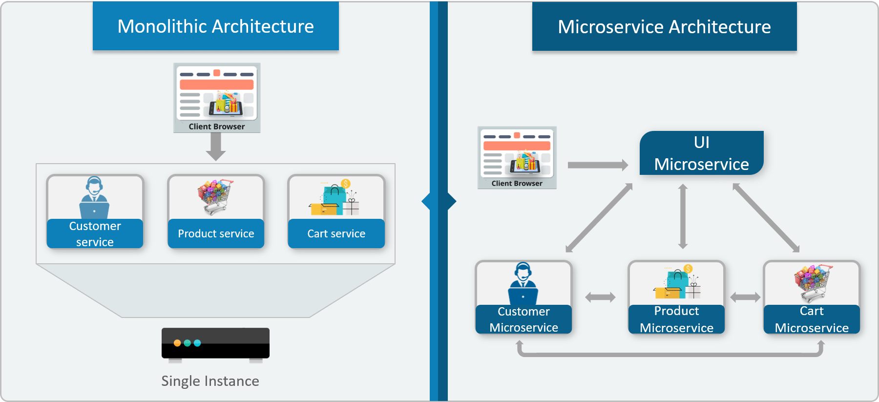
Differences Between Traditional Architecture and Microservices

Slide 9
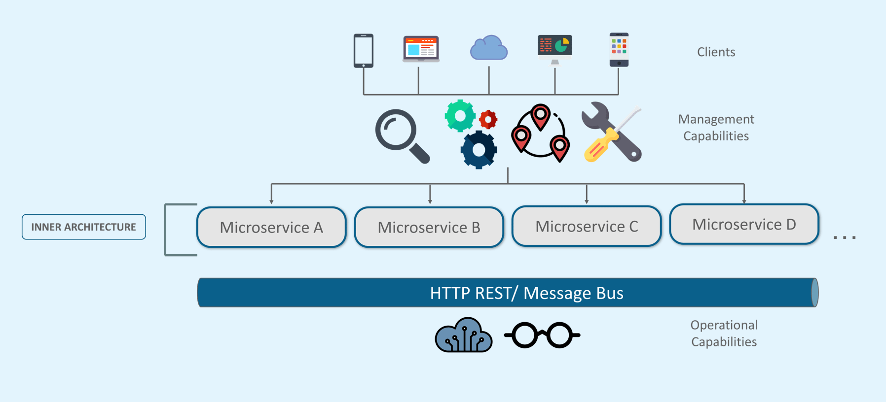
Architecture of Microservices

Slide 10
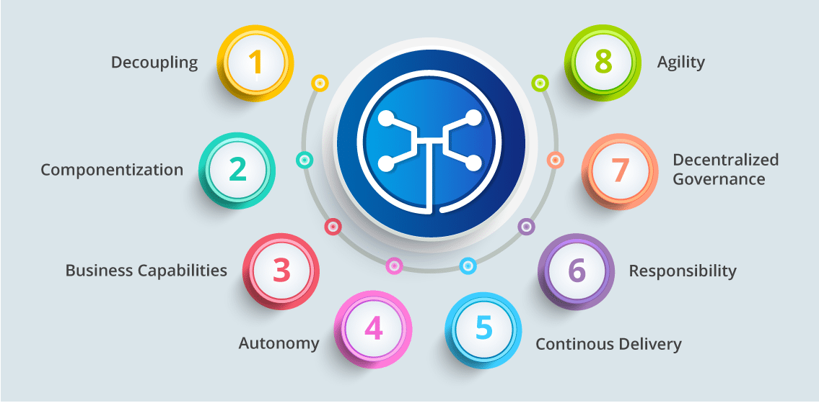
Features of Microservices

Slide 11
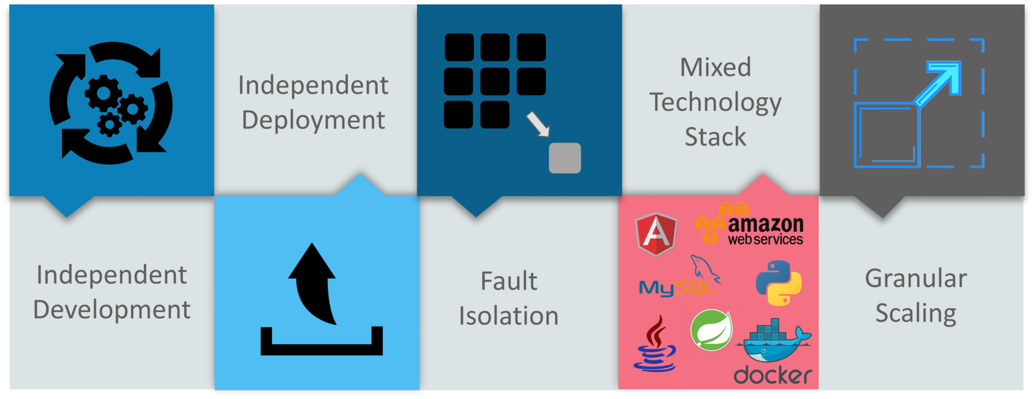
Advantages Of Microservices

Slide 12
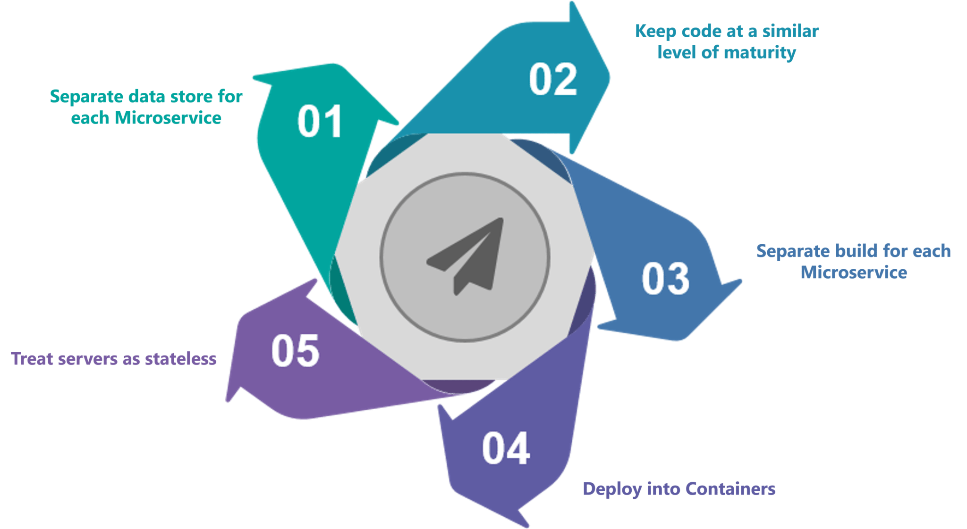
Best Practises Of Microservices

Slide 13
Best Practises Of Microservices
Improve the Productivity with Domain-Driven Design
Consider a Good Infrastructure
Data Storage Separation is Must
Migration
Single Responsibility Principle
Use API Changes that are Compatible.
Monitoring and Logging
Develop a Splitting System
Separately Deploy the Microservices
Develop the Organizational Efficiencies

Slide 14
Microservice design Patterns
Managing a microservices architecture involves a variety of complex challenges that are seldom encountered in traditional monolithic systems. These challenges include:
Service orchestration: Ensuring that multiple, independent services communicate seamlessly to execute complex business processes.
Fault tolerance: In a distributed system, a failure in one service shouldn’t lead to a system-wide collapse.
Data consistency: Unlike monolithic systems where you can rely on ACID transactions in a single database, microservices often have their own databases, making transactional consistency a big concern.
Service discoverability: How services locate each other in a dynamically scaling environment.

Slide 15
Microservice design Patterns
Saga Pattern
Circuit Breaker
API Gateway
Event-Driven Architecture
Backends for Frontends (BFF)
Service Registry
Database per Service
Command Query Responsibility Segregation (CQRS)
Externalized Configuration
Bulkhead Pattern

Slide 16
Choosing design Patterns
Choosing the right design patterns for your microservices architecture is critical for building a robust and scalable system. Here are a few factors to consider while making your choice.
Assess service interdependencies:
Evaluate resilience requirements:
Consider security implications:
Reusability and future-proofing:

Slide 17
LAB

Slide 18
Thank you

